Slide 1
Domain: Socio-economic Development
Project 3: Increasing the Sustainability of Urban Foodscapes through Agri-Food Entrepreneurship

Slide 2
Domain: Socio-economic Development
Project 3: Increasing the Sustainability of Urban Foodscapes through Agri-Food Entrepreneurship
Team Leaders
For ARDHI: dr. Makarius Victor Mdemu
makmdemu@gmail.com
For UGent: Prof. Joost Dessein
Joost.Dessein@ugent.be

Slide 3
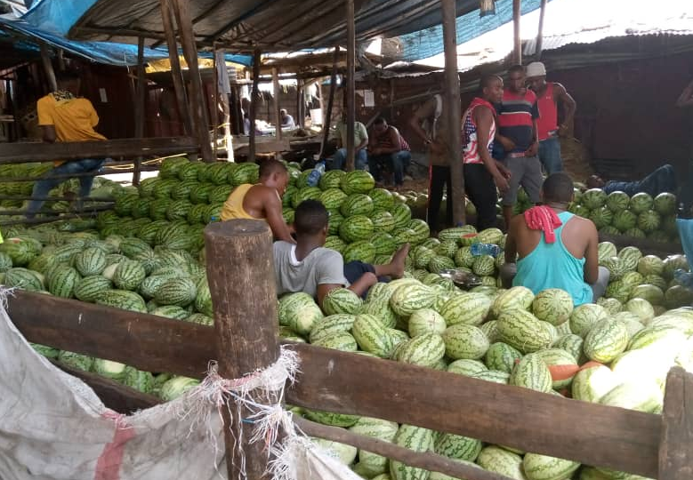
Project context
Urban and peri-urban areas offer enormous economic opportunities for agripreneurship, agrifood industry and agrifood-tourism. Nonetheless, these are largely under-exploited.
In particular, Urban and Peri-urban Agriculture (UPA) is a key component of an urban foodscape that requires attention.
For Dar es Salaam, UPA is instrumental for:
enhancing food access;
offering opportunity for urban entrepreneurship, mostly to women and youth; and
inclusion and empowerment of marginalized groups.

Slide 4
Main objective To contribute to enhanced entrepreneurship in the foodscape of (peri-) urban Dar Es Salaam in order to improve the livelihoods in its deprived communities.
Specific objective 3
Specific objective 1
To contribute to an enabling governance environment, by initiating a Food Policy Council in the three selected locations
in Dar Es Salaam
To map the different networks of food provisioning, leading to a typology of the foodscape of Dar es Salaam.
Specivic objective 4
Specific objective 2
To investigate if and how the foodscape of Dar es Salaam can serve as a laboratory for other cities, and how ARU can play
a pivotal role in this, using the vehicle of the African Centre for Sustainable Cities Studies.
To assess which business models can enhance the performance of agri-food entrepreneurs (SMEs) in order to increase
their livelihood conditions

Slide 5
Project Strategy
Research:
Outputs: Typologies of the foodscape of Dar es Salaam, Business models for enhanced performance of agro-food entrepreneurs, and sustainable agri-food tourism, and knowledge about Food Policy Councils
Long-term achievements:
A resilient and diverse network of economically performant agri-food enterprises
8 PhD and 8 masters
16 peer reviewed publications, and 16 conference contributions
2 policy briefs
3 food policy councils
Master programme in Urban Economics
Societal Outreach: Engaging with targeted groups (with a focus on women and youth in agri-food businesses, as well as local policy makers)
Education and Training:
50:50 male-female ratio; 8 MSc and 8 PhDs.

Slide 6
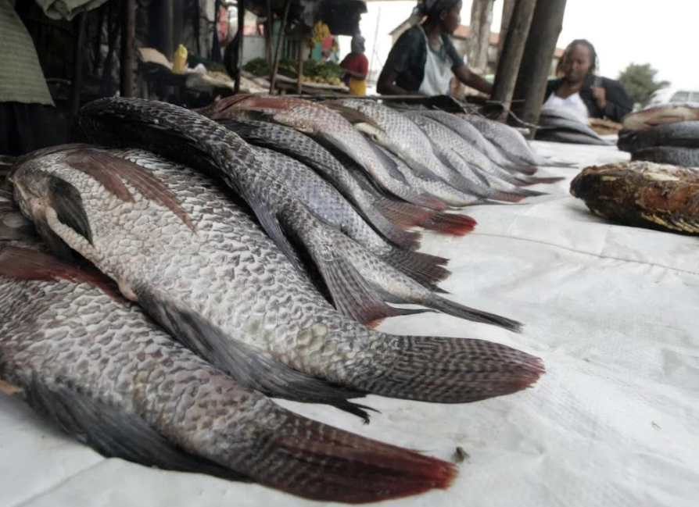
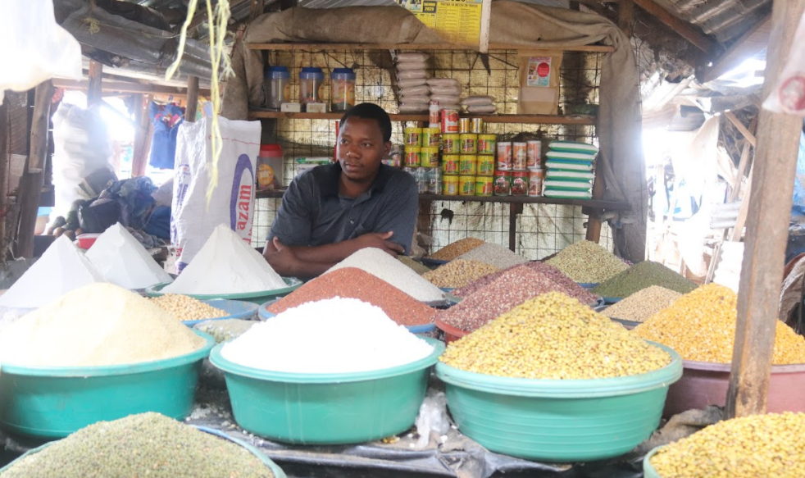
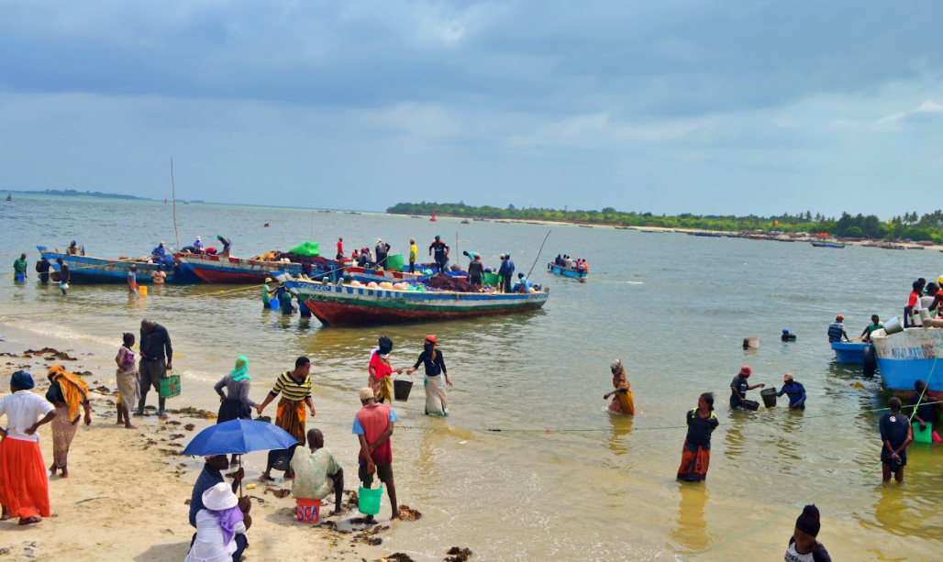
Project end-users
Agri-food entrepreneurs and (Peri-) urban farmers: Including women and youth
1
Academic and Training Institutions: Ardhi University, University of Dar es Salaam, National College of Tourism, etc.
2
Private Sector Stakeholders: Hotels, Companies related to food, tourism, food processing, etc.
3
Government: Relevant ministries and Local Government Authorities
4

Slide 7
Asante –Thank you

